Slide 1
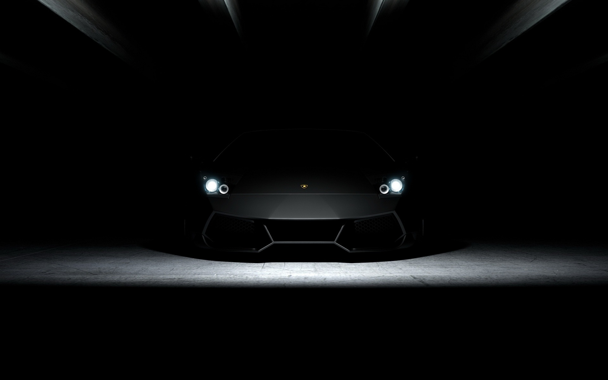
VOICE CONTROLLED OBSTACLE DETECTOR CAR
Done by Aravind, Aravind balaji ,Ebenezer
Notes:
Intro

Slide 2
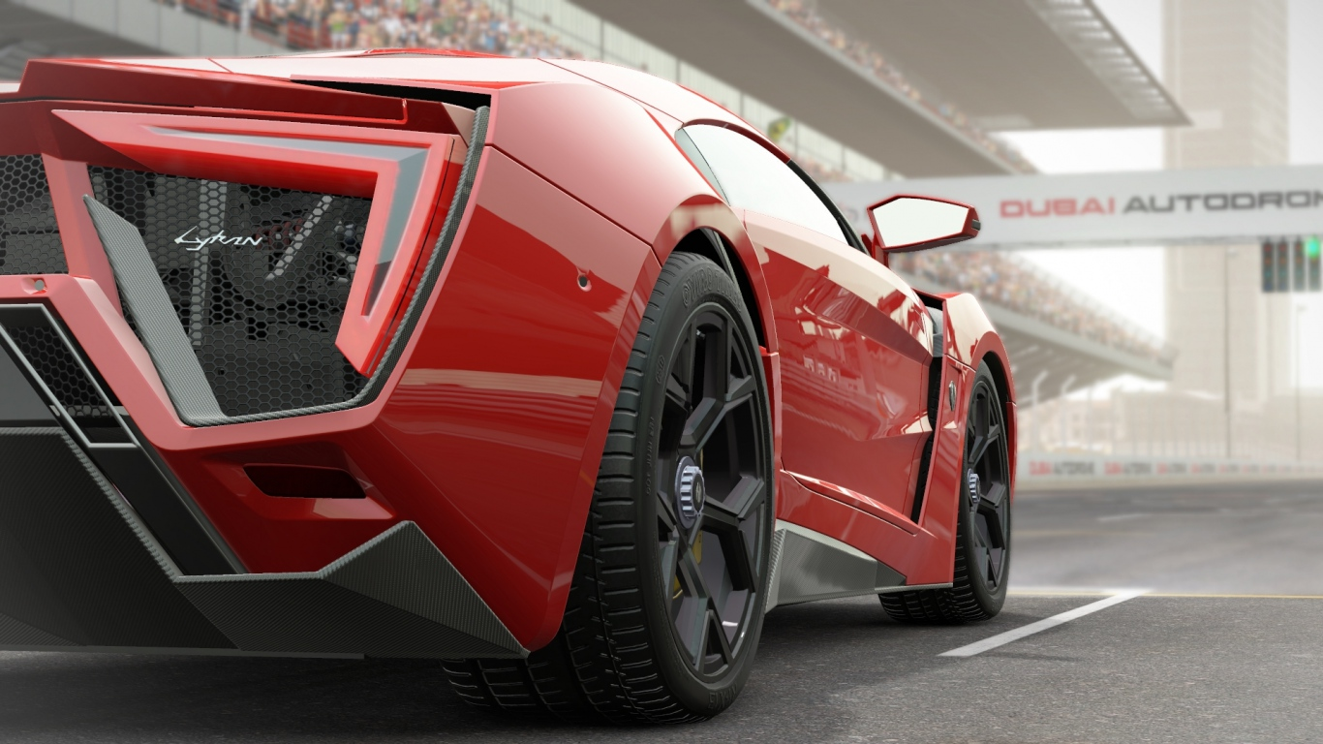
ITEMS REQUIRED
ARDUNIO
IR SENSOR
Bluetooth Module HC-05
Photoresistor( LDR)
IR Obstacle Sensor
L293D H-bridge Motor Driver

Slide 3

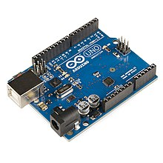
ARDUNIO ( microcontroller)
Features :
1. Microcontroller: ATmega328.
2. Operating Voltage: 5V.
3. Input Voltage (recommended): 7-12V.
4. Input Voltage (limits): 6-20V.
5. Digital I/O Pins: 14 (of which 6provide PWM output)
6. Analog Input Pins: 6.
7. DC Current per I/O Pin: 40 mA.
8. DC Current for 3.3V Pin: 50 mA.

Slide 4

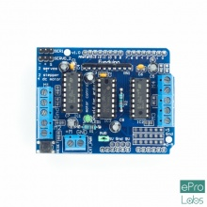
L293D H-bridge Motor Driver
Specifications
1. Supply Voltage Range 4.5V to 36V.
2. 600-mA Output current capability per driver.
3. Separate Input-logic supply.
It can drive small DC-geared motors, bipolar stepper motor.
4. Pulsed Current 1.2-A Per Driver.
Thermal Shutdown.
5.Internal ESD Protection.
High-Noise-Immunity Inputs.

Slide 5

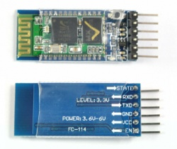
Bluetooth Module HC-05
HC-05 Specification:
1. Bluetooth protocal: Bluetooth Specification v2.0+EDR.
2. Frequency: 2.4GHz ISM band.
3. Modulation:GFSK
4. Emission power: ≤4dBm, Class 2.
5. Sensitivity: ≤-84dBm at 0.1% BER.
6. Speed: Asynchronous: 2.1Mbps(Max) / 160 kbps, Synchronous: 1Mbps/1Mbps.

Slide 6

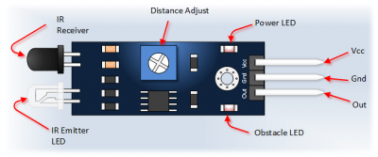
IR Obstacle Sensor
Specifications
1. Operating Voltage: 3.0V – 5.0V
2. Detection range: 2cm – 30cm (Adjustable using potentiometer)
3. Current Consumption:at 3.3V : ~23 mA,at 5.0V: ~43 mA
4. Active output level: Outputs Low logic level when obstacle is detected
On board Obstacle Detection LED indicator

Slide 7

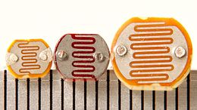
Photoresistor( LDR)
5 more rows
1. Max power dissipation | 200mW
2. Max voltage @ 0 lux | 200V
3. Peak wavelength | 600nm
4. Min. resistance @ 10lux | 1.8kΩ
5. Max. resistance @ 10lux | 4.5kΩ
6. Typ. resistance @ 100lux | 0.7kΩ

Slide 8

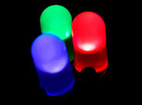
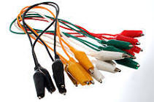
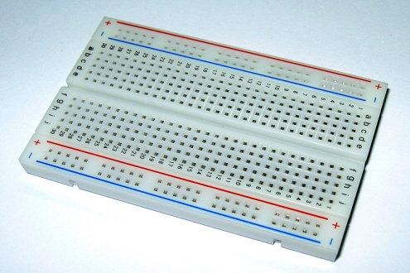
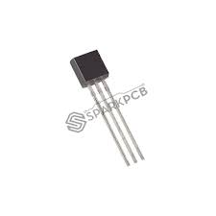
OTHER MATERIALS
Light-emitting diode (LED)
2. JUMP WIRE
3. BREADBOARD
4. BC547 TRANSISTOR

Slide 9
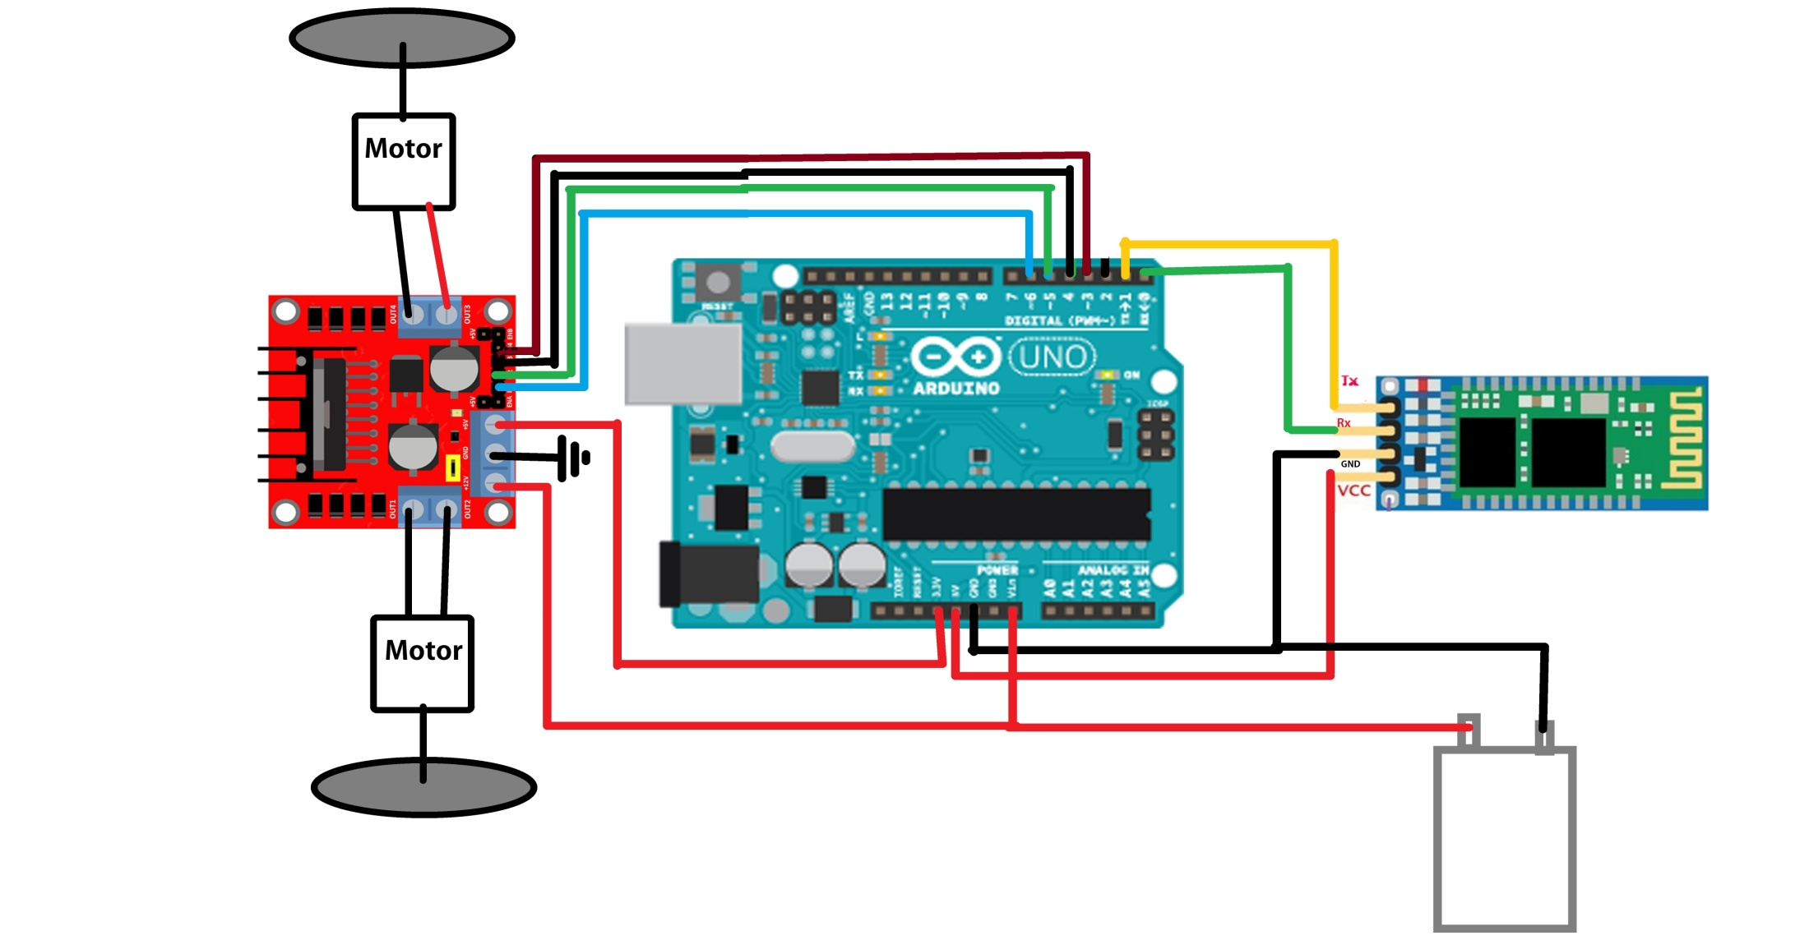
Circuit diagram

Slide 10

Process
VOICE AS INPUT FROM PHONE\LAPTOP
Ardunio takes in the input and gives an output as per the code
Received by the bt module HC-05
If any obstacle is sense by ir- sensor it notifies the ardunio board
Ardunio sends the output which cuts the supply as per the code and the car stops

Slide 11
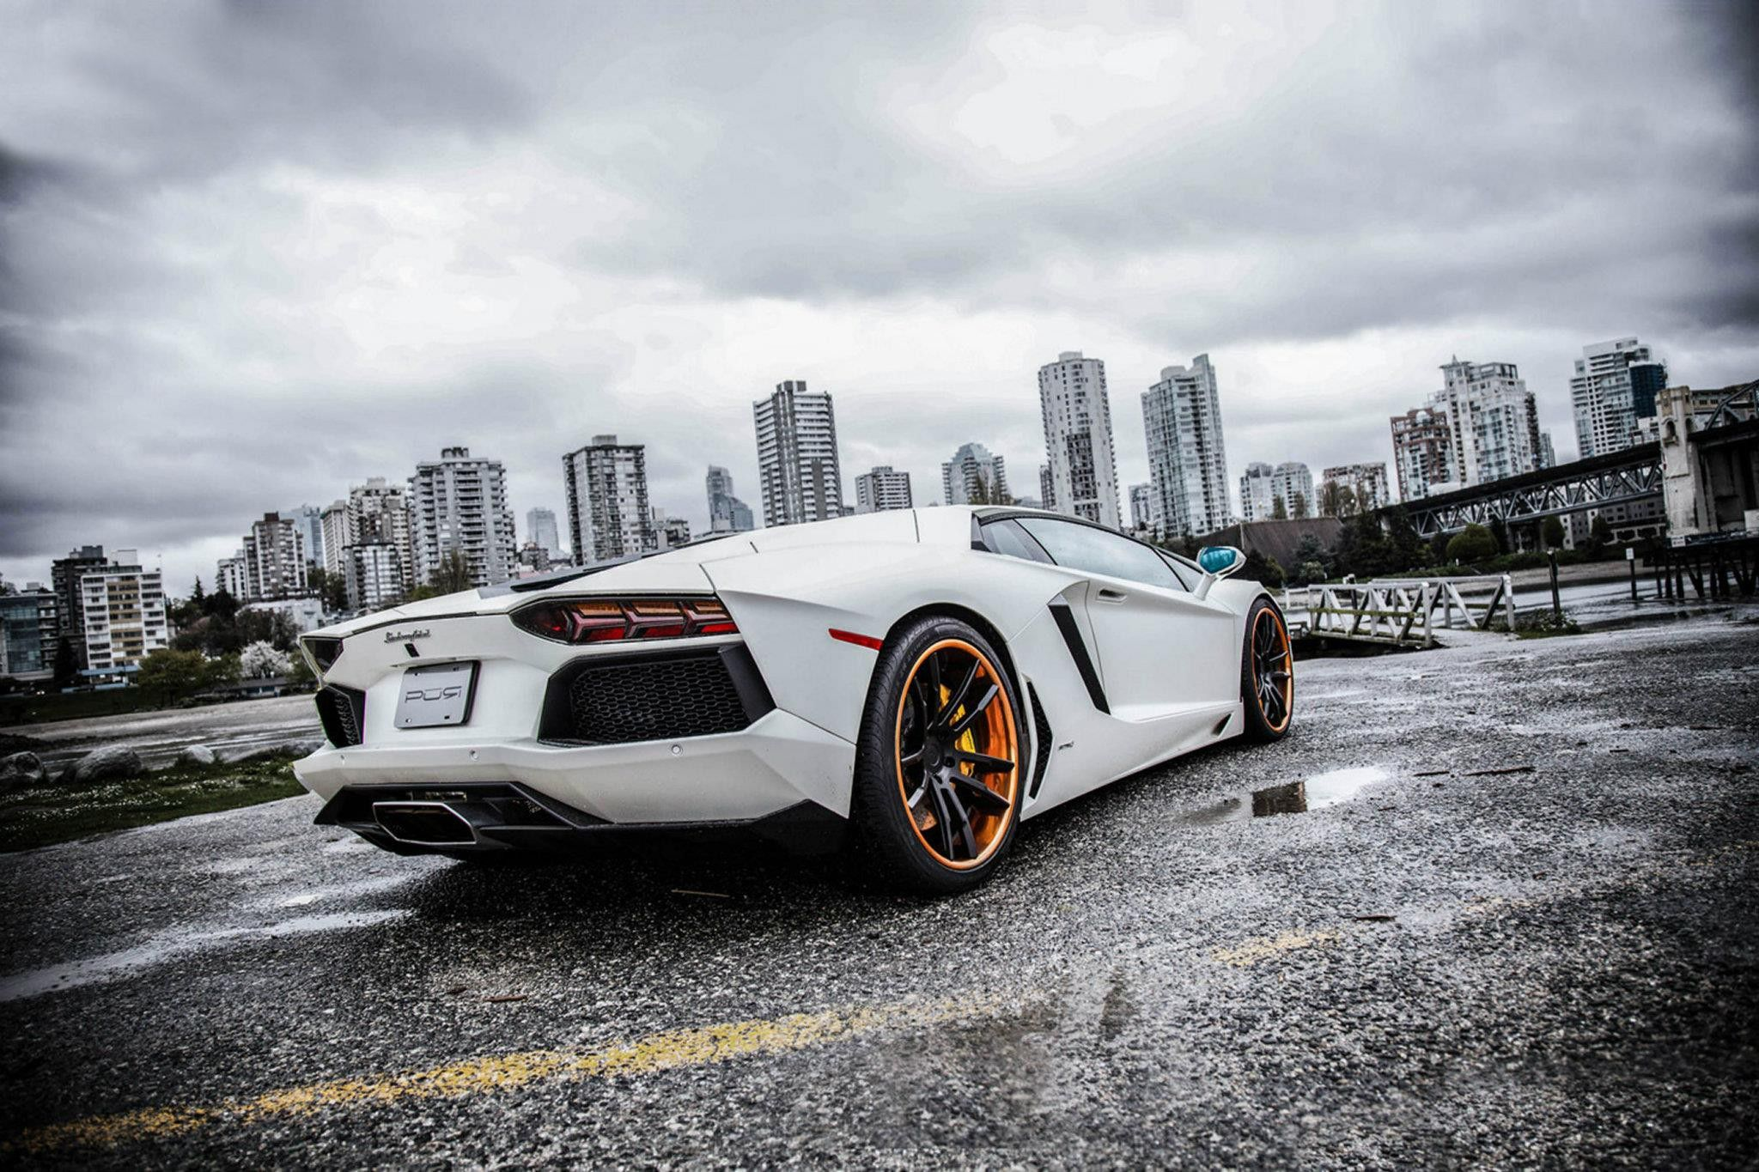
Application
Can be used as commercial vehicle
Can be used as military vehicle
Even small children can drive these vehicle easily
Senior citizen can drive these vehicle easily
Safe
Physically challenged people can drive these vehicle

Slide 12
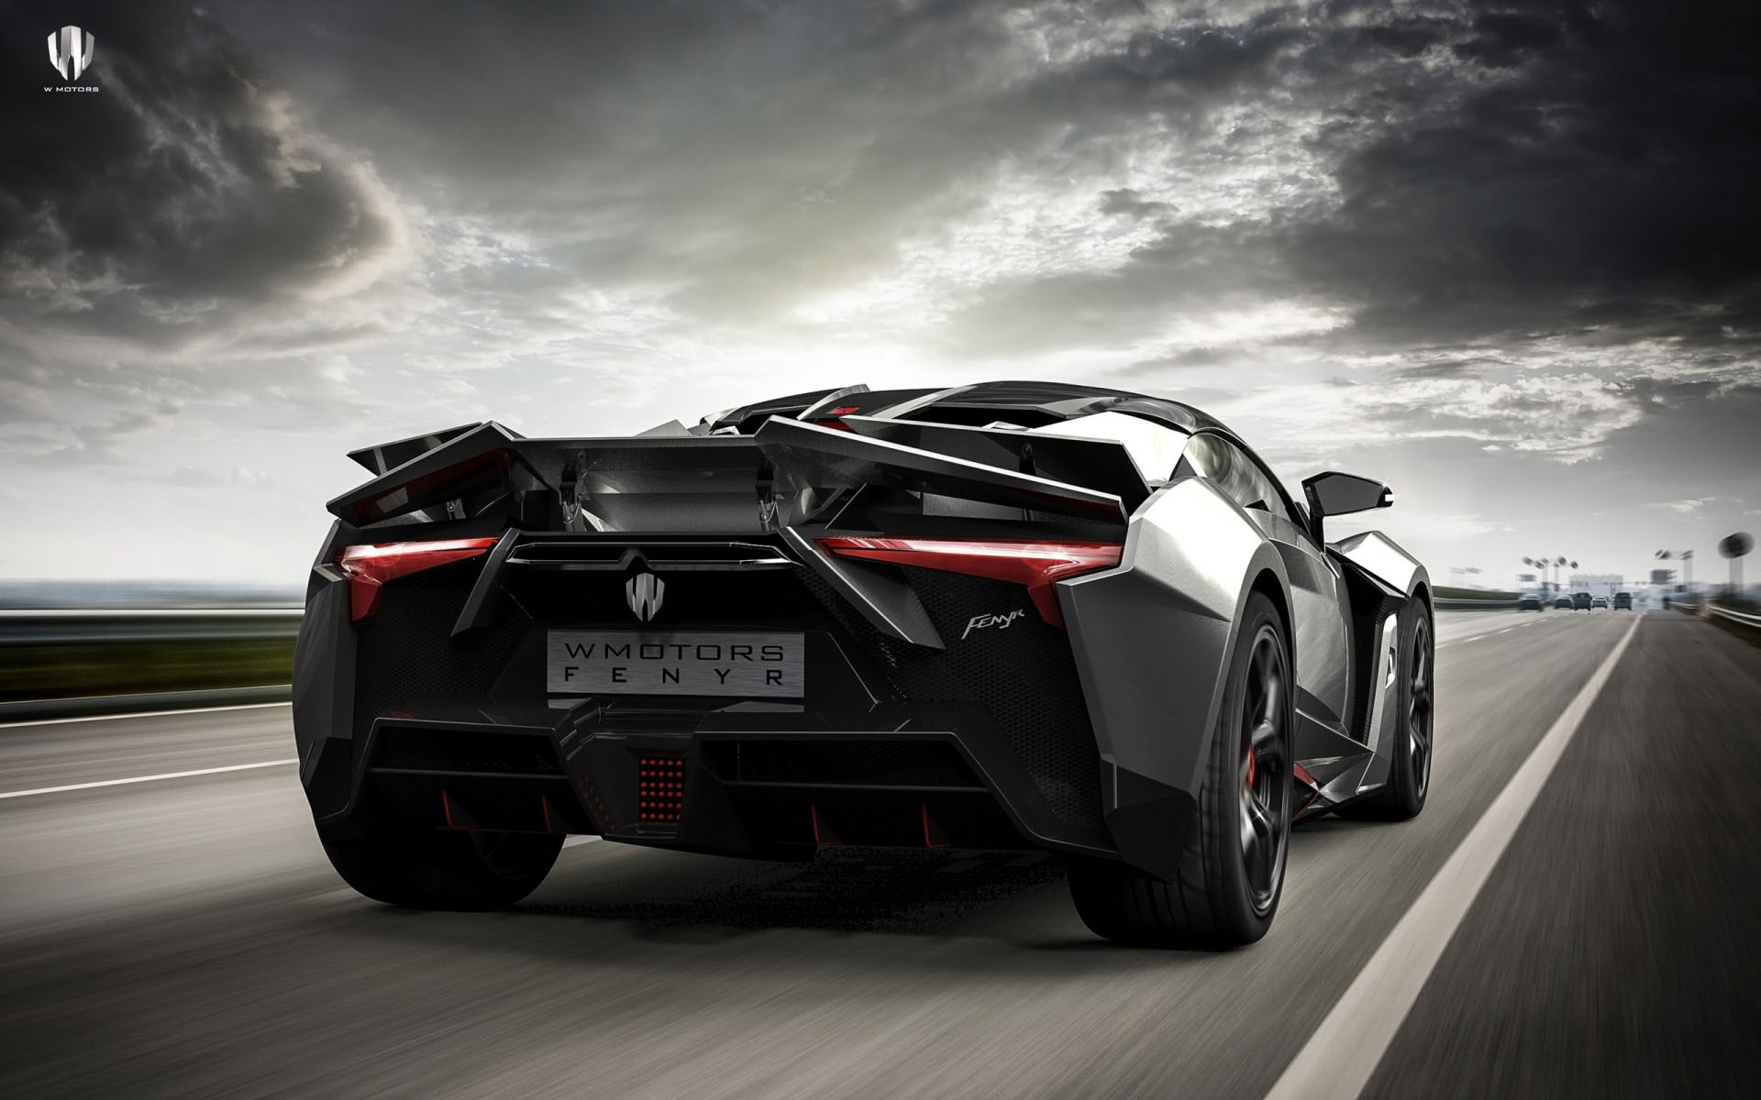
“Every ENDING is REALLY just a NEW BEGNING” THANK YOU FOR LISTENING
HOPE YOU HAVE UNDERSTOOD OUR PROJECT

